Slide 1

Stock
Fundamental Analysis
Presented by: Project SFA
Date: May 20, 2021

Slide 2
Team
Jackie You
Victor Ng
Jamal Rizvi

Slide 3
Executive Summary
This project aims to generate stock fundamental analysis encompassing three aspects:
Return on Equity (ROE) and its main drivers
Free Cash Flow Return on Equity and its main drivers
Valuation and future growth potential
By using financial programming, the project provides benefits relative to manual work in terms of:
Real time data
Efficiency by saving manual labor
Accuracy by eliminating human error
Dynamism in response to evolving user requirements
FinTech rocks!!!

Slide 4
User Story & Acceptance Criteria for MVP
User | Requirements | Value Driver | Priority | User Story | Acceptance Criteria | Comments
Investor | Ability to evaluate a stock's ROE and its drivers, Free Cash Flow and its drivers, growth potential and valuation. | Generate results quickly, accurately, using real time data, and can adapt to dynamic changes in requirements | Must | As an investor, I need the ability to evaluate a stock's ROE and its drivers, Free Cash Flow and its drivers, growth potential and valuation, so that I can generate results quickly, accurately, using real time data, and can adapt to dynamic changes in requirements | Precondition: 1) The stock has been listed long enough to have the necessary financial data available. Acceptance Criteria: 1) Ticker symbols are defined by the User. 2) Stock data all come from database through API. 3) Forward growth assumption is input by the User. 4) Output is in dataframes and charts | All Met

Slide 5
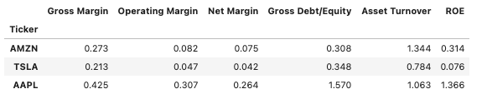
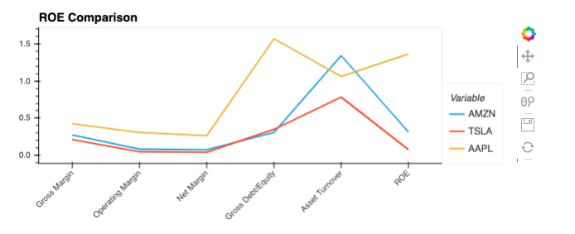
Results of the Project - ROE Output

Slide 6
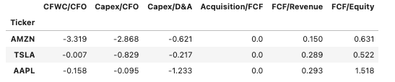
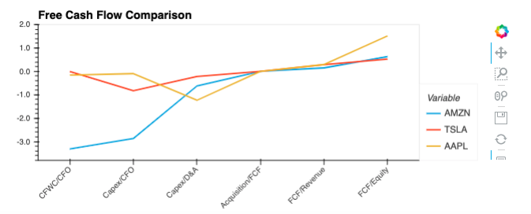
Results of the Project - Free Cash Flow Output

Slide 7
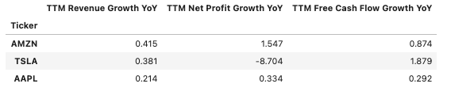
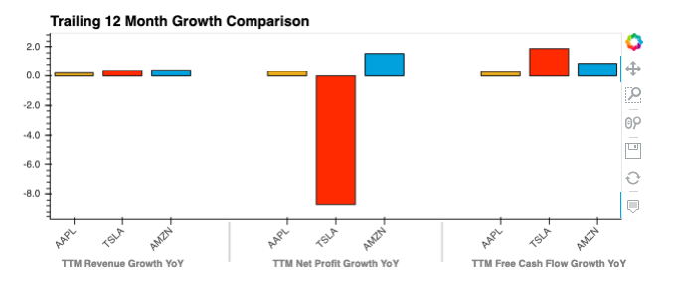
Results of the Project - TTM Growth Rate

Slide 8
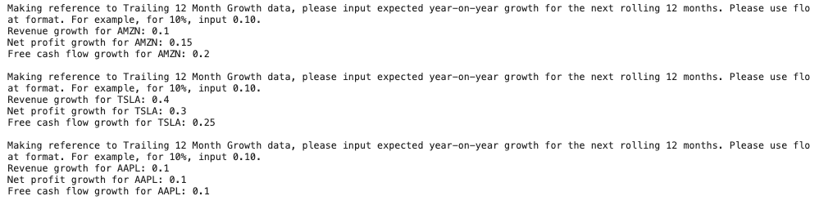
Results of the Project - User Input of Assumptions

Slide 9
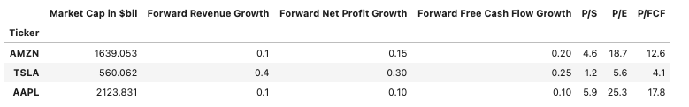
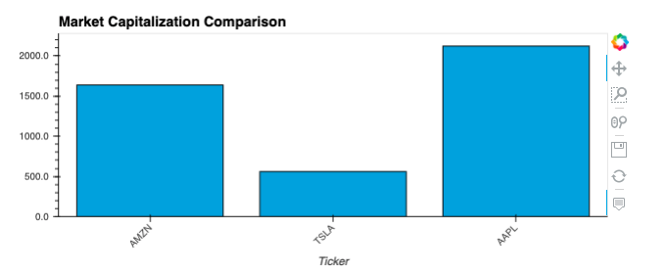
Results of the Project - Valuation Output

Slide 10
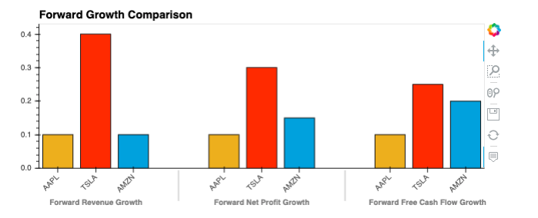
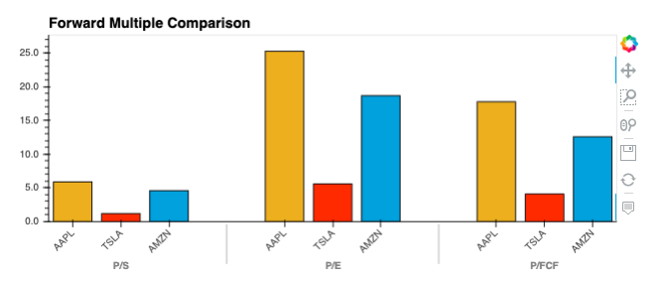
Results of the Project - Forward Growth vs. Multiples

Slide 11
Data Collection, Cleanup & Exploration
Data Source: https://financialmodelingprep.com/
Focus Areas | Explanation
Benefits | Data are comprehensive and curated
Data collection | Through paid API
Data cleanup | Minimal as data is already curated
Data exploration | Has any historical data one can think of in terms of types and duration

Slide 12
Approach of the Project
New library: FundamentalAnalysis
Tools utilized:
API & .env
Pandas
Hvplot
CSV file interaction
User input

Slide 13
Approach of the Project - Code Structure
Make ticker list from csv file with user input
Use “for loop” for the ticker list
Define dataframes and specify columns
Extract data from databases using API
Prompt user input where needed
Calculate data output
Insert data into dataframes
Display dataframes and charts

Slide 14
The Unanticipated
The real life impact 7 weeks into the Boot Camp was beyond our imagination!
Updating OS disrupted the progress of the project. Resolved speedily with the help of the Instructional Team and Tutor. Thank you!!!

Slide 15
Next Steps
Handle situations where cash flow and profit data are negative;
Provide feedback message for user where there is not sufficient data for a relatively new stock;
Add dividend payout ratio and buyback ratio;
Get user input of sizes of user base of stocks where appropriate;
Add single stock time series trend analysis.
Questions for further research:
Is it possible to analyze revenue segments which are highly company-specific with coding?

